Slide 1

Designing a Systematic, Low-Cost Engineering Framework for Paper Aircraft
Exploring Trade-Offs and Potentials for Micro-UAV Development
A low-cost framework for optimizing paper aircraft through computer vision tracking and iterative design methodology, with transferability to micro-UAV development.

Slide 2
What Is a "Systematic Engineering Framework"
Framework
Systematic Engineering Framework
a set of organized rules and methods that guide how you approach a problem
an organized approach that guides you through solving engineering problems step-by-step. Instead of randomly trying different things and hoping something works, you follow structured methods to understand what changes actually improve performance and why
Systematic Engineering
following a structured, step-by-step process instead of random trial-and-error

Slide 3
Micro-UAVS: what and why
Tiny & Lightweight
Highly Maneuverable
Cost-Effective
Miniature drones smaller than 15cm in size, often less than 100g, designed for delicate tasks.
Navigate tight, hard-to-reach spaces with precision.
Inexpensive to build and operate, reducing research costs.

Slide 4
Putting it togerher, What Our Research Is About?
01
02
Designing Framework for making good performing paper planes
Finding if using this is have benfetis to real world applications specifically micro-uav

Slide 5





Literature Review: Key Insights
Paper Aircraft Research
Traditionally educational, limited optimization. Heavy reliance on trial-and-error. A clear gap for systematic engineering frameworks.
Systematic Design
Foundation of professional engineering. Emphasizes controlled variables, measurable outcomes, and single-variable modification for reproducible results.
Micro-UAV Development
Methodical, iterative design processes, similar to proposed paper aircraft framework. Focus on systematic optimization and performance measurement.
Computer Vision
Standard for objective flight analysis in aerospace. Provides consistent, repeatable trajectory tracking, crucial for quantitative performance data.
Transfer Effectiveness
Methodical learning in simplified systems (like paper aircraft) directly transfers analytical skills to complex professional engineering challenges.

Slide 6

The Problem with Trial-and-Error
Inefficient Learning
Time Consumption
No Transferable Skills
Traditional approaches don't teach underlying aerodynamic principles or provide systematic pathways to improvement.
Random modifications waste time without clear documentation of what works and what doesn't.
Lacks organized approaches that develop engineering competencies for real-world applications.

Slide 7
Methodology

Slide 8
Framework Requirements
01
02
03
Systematic Approach
Quantitative Measurement
Repeatable Results
Methodical design process with clear protocols and documentation requirements.
Objective performance metrics including distance, airtime, speed, trajectory, and stability scores.
Reproducible methodology that works consistently across different users and testing sessions.

Slide 9
Reference Points
1
2
Baseline Model: The Classic Dart
Benchmark Model
Establishes a minimum flight reference. The classic paper dart is ideal due to its ease of folding, reliable flight, and clear room for improvement. It provides a measurable starting point for any new design.
Defines an excellent performance target. This model should fly far and demonstrate solid overall flight. Benchmarks offer insights into advanced design elements like control surface integration and optimal center of mass positioning.

Slide 10

Lucidraft Software Solution
Digital Engineering Notebook
Organized folder structure for models and versions with metadata, metrics, and analysis files. Eliminates the disorganization of traditional notebooks.
Computer Vision Integration
CSRT tracking algorithm records flight videos, maps trajectories, and generates performance graphs with average trajectory calculations.

Slide 11





What It Provides: Structured Documentation
Messy, disorganized notes
Automatic folder structure
The documentation problem
Lucidraft's Solution
Manual tracking issues
Version control and tracking

Slide 12




Organized Project Structure
Every Version Contains:
outputs/
├── ModelName/
├── 1.0/
│ ├── metadata.txt
│ ├── model_picture.jpg
│ ├── Flight Videos/
│ ├── Flight Coordinates/
│ ├── Flight Metrics/
│ ├── avg_metrics.csv
│ ├── avg_coordinates.csv
│ └── report.md
└── 1.1/
└── (same structure)
Design notes and metadata
Flight videos and trajectories
Performance metrics
Generated reports

Slide 13
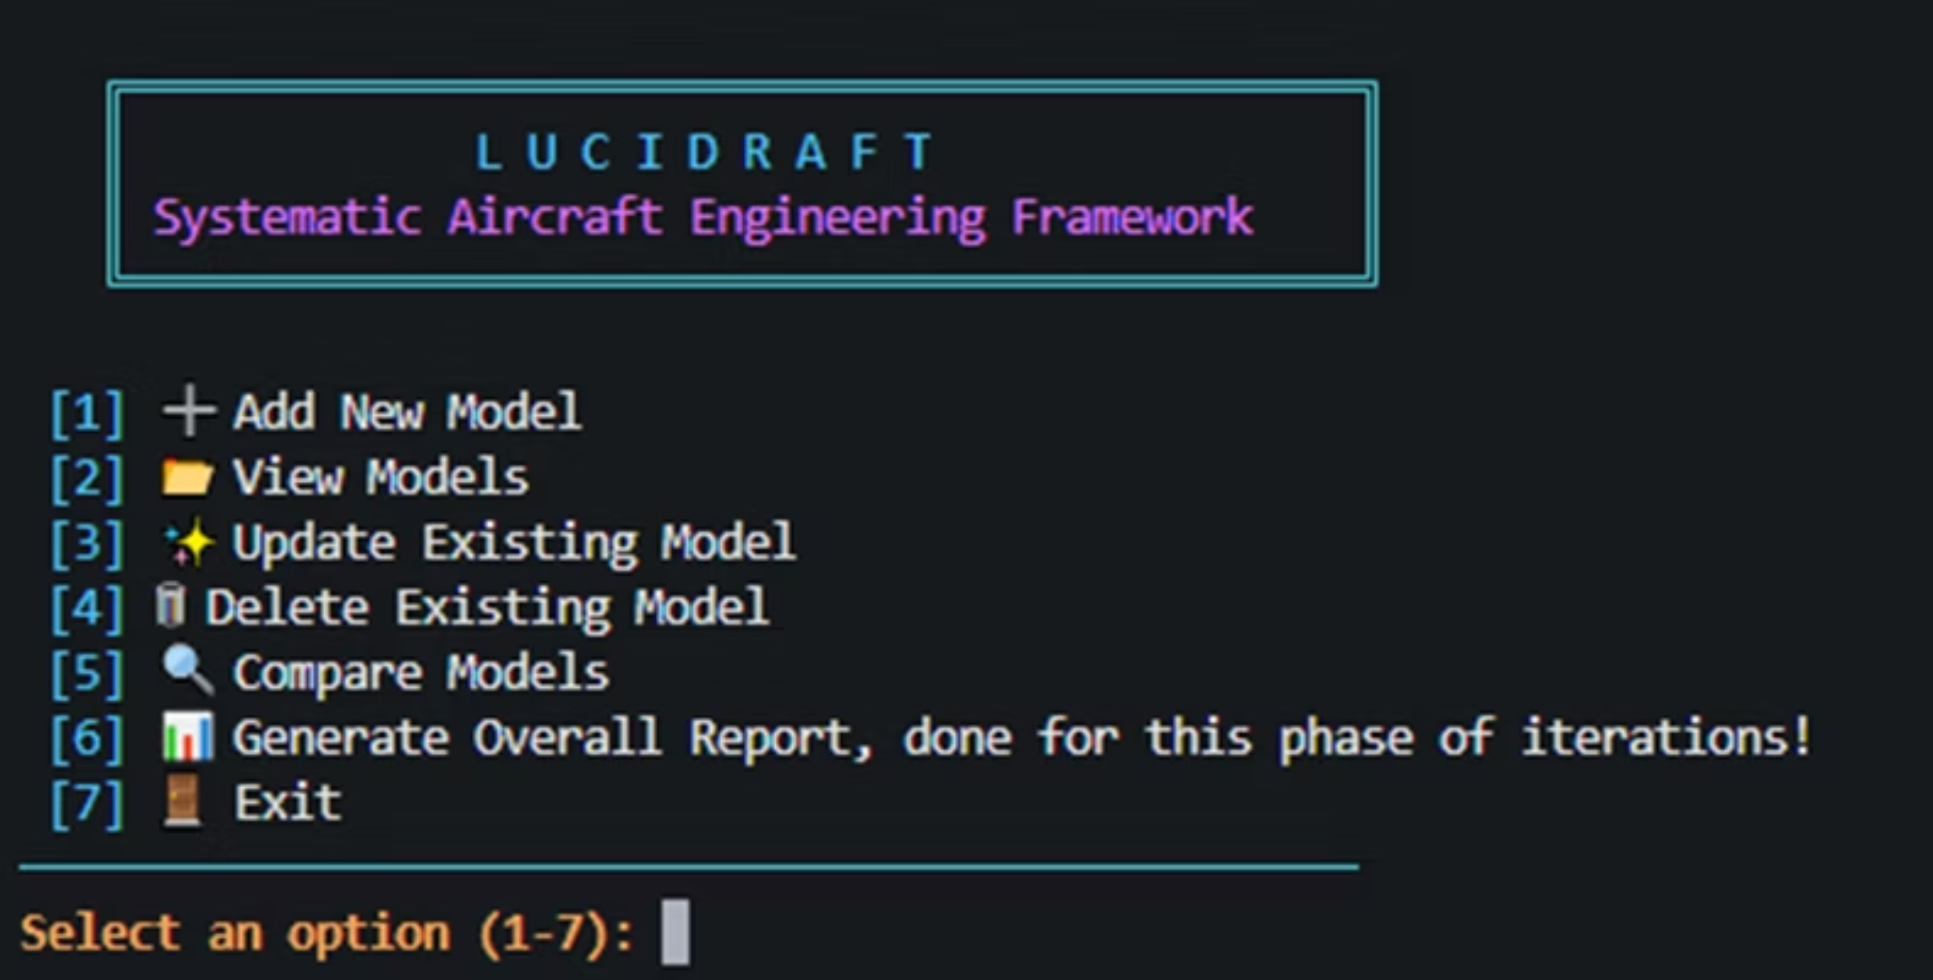
Lucidraft Core Functions
CRUD operation
comparision
report generation

Slide 14
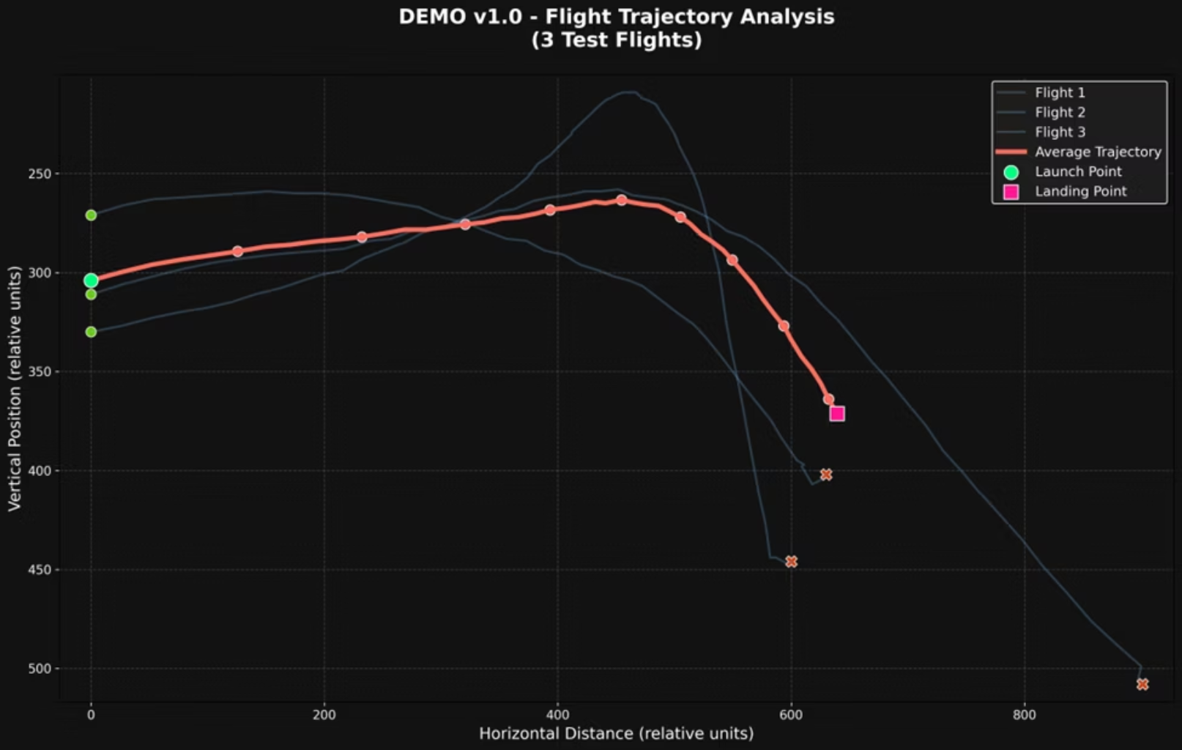
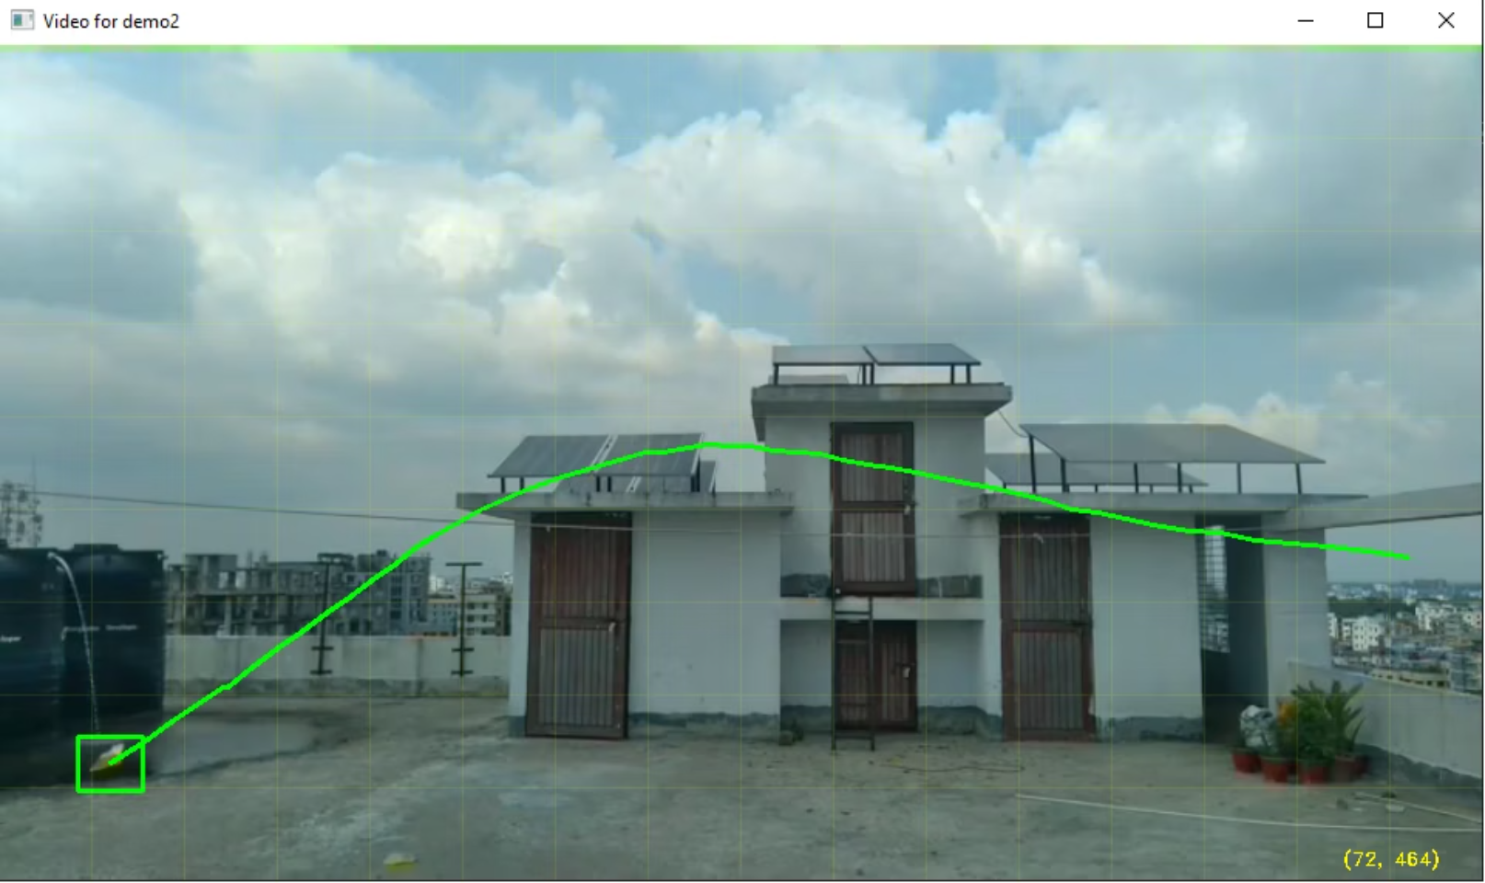
Analyzing Process

Slide 15




Single-Variable Modification Protocol
One Change Per Iteration
Modify only one variable at a time to isolate cause-and-effect relationships.
Document Everything
Record the change made, hypothesis, and reasoning for each modification.
Analyze Results
Compare performance data to determine if changes improved or decreased performance.

Slide 16
Performance Metrics
8-15m
4-8s
6-8/10
Realistic Distance Goals
Airtime Targets
Stability Score
Achievable targets through methodical improvements
Measured through frame count analysis
Standardized assessment protocol
Stability scoring ranges from 0-2 (severe instability) to 9-10 (exceptional stability with smooth, predictable trajectory).

Slide 17




Equipment and Material Specifications
Measurement Tools
Distance is measured with a measuring tape. Airtime is calculated by Lucidraft's frame count, with an optional manual stopwatch for verification.
Recording Setup
Maintain consistent camera, tripod height, and distance from the flight area. Ensure adequate lighting. Monitor environmental factors like wind (<2mph), temperature, and humidity for consistent results.
Computing Platform
A standard computer running Python with OpenCV is sufficient. No specialized hardware is needed beyond a basic webcam or smartphone for video recording, with minimal processing power required for analysis.
Material Standardization
Primary material is paper (70-80gsm for origami, 200-300gsm for stiffer designs). Secondary materials include tape for reinforcement, a ruler for crisp folds, paper clips for weight adjustment, and rubber bands for launcher use.

Slide 18




Operator Consistency and Bias Mitigation
Dedicated Operator
Consistent Throws
Different people have different throwing style which can affect the results
Maintain a standardized throwing technique (angle, release height, force).
Validate repeatability with baseline throws (e.g., distance variation < 30%).
Cross-Validation
Key designs are cross-validated by 2-3 different operators.
This mitigates bias and confirms design improvements are not operator-specific.

Slide 19
Micro-UAV Translation Assessment Methodology
1
2
3
Primary Research Question
Investigation Approach
Hypothesis
We analyze transferable design principles, the relevance of testing methodology, and the applicability of skill development by comparing paper aircraft engineering concepts with established micro-UAV practices.
Systematic paper aircraft engineering provides transferable skills in aerodynamic trade-off analysis, testing protocols, and iterative design optimization directly applicable to micro-UAV development.
Does systematic paper aircraft engineering contribute meaningful insights to micro-UAV development, or is it limited to educational value only?

Slide 20



Framework Validation Approach
Systematic vs. Ad-Hoc
Effectiveness Criteria
Low-Cost Validation
Framework designed to enable systematic vs. ad-hoc comparison through enforced documentation and methodology
The framework is validated if it demonstrates measurable performance improvements, clear documentation of changes, and trackable progress over conventional approaches.
Framework utilizes standard household materials (paper, tape, measuring tools) and basic computing equipment, ensuring minimal cost for users while maintaining professional-level engineering capabilities.

Slide 21
Results

Slide 22



Low-Cost Implementation
Standard Materials
Basic Computing
Simple Recording
70-80gsm paper for origami designs, 200-300gsm for stiffer constructions, tape, paper clips, and measuring tools.
Any standard computer capable of running Python applications with OpenCV support. No specialized hardware required.
Basic webcam or smartphone for video recording with consistent setup and lighting conditions.

Slide 23

Micro-UAV Transferability
Transferable Skills
Iterative design optimization
Trade-off analysis (stability vs performance)
Systematic testing protocols
Data-driven decision making
Professional Relevance
Academic research confirms systematic paper aircraft engineering contributes meaningful insights to micro-UAV development beyond educational value.
Scalability Limitations
Material constraints, manufacturing complexity, and power systems differ significantly from paper aircraft to operational micro-UAVs.

Slide 24



Framework Effectiveness Results
Systematic Documentation
Structured Data Collection
Time Efficiency
Faster overall progress compared to unsystematic trial-and-error methods.
Creates searchable knowledge base preventing repetition of failed approaches.
Structured data input and computer vision trajectory analysis reduces subjective bias compared to pure visual assessment

Slide 25

Future Research Directions
1
Enhanced Measurement Systems
Statistical significance testing and objective stability measurement using accelerometer data or advanced computer vision.
2
Expanded Accessibility
Web-based implementation and smartphone tracking applications to eliminate computer requirements.
3
Advanced UAV Integration
Electronics integration, sensor incorporation, and transition methodologies from passive to powered aircraft design.
4
Comprehensive User Testing
Extended validation with diverse user groups to empirically demonstrate framework effectiveness.

Slide 26

Thank You
We appreciate your time and attention to our research. We are excited about the future possibilities of systematic paper aircraft engineering and its applications to micro-UAV development.

